Slide 1
CS217 – Object Oriented Programming (OOP)
Week – 07
Mar 14- Mar 18, 2022
Instructor: Basit Ali

Slide 2
Inheritance
Capability of a class to derive properties and characteristics from another class.
One of the most important feature of Object Oriented Programming
Inheritance represents the IS-A relationship which is also known as a parent-child relationship.

Slide 3
Concepts
Sub Class: The class that inherits properties from another class is called Sub class or Derived Class or Child Class.
Super Class: The class whose properties are inherited by sub class is called Base Class or Super class or Parent Class.

Slide 4
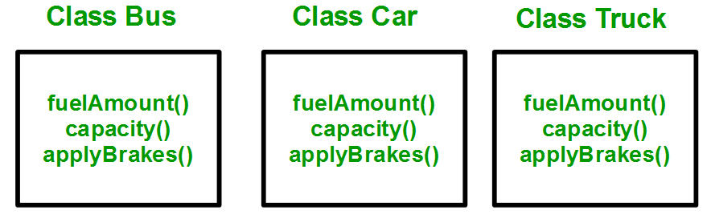
Why and when to use inheritance?
Consider a group of vehicles. You need to create classes for Bus, Car and Truck. The methods fuelAmount(), capacity(), applyBrakes() will be same for all of the three classes.

Slide 5
Why and when to use inheritance?
You can clearly see that above process results in duplication of same code 3 times. This increases the chances of error and data redundancy. To avoid this type of situation, inheritance is used.

Slide 6
Why and when to use inheritance?
If we create a class Vehicle and write these three functions in it and inherit the rest of the classes from the vehicle class, then we can simply avoid the duplication of data and increase re-usability.

Slide 7
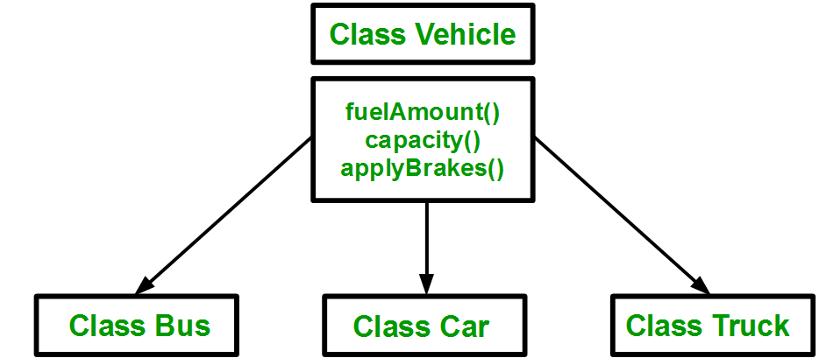
Why and when to use inheritance?

Slide 8
Implementing inheritance
Syntax:
class Subclass-name extends Superclass-name
{
//methods and fields
}

Slide 9
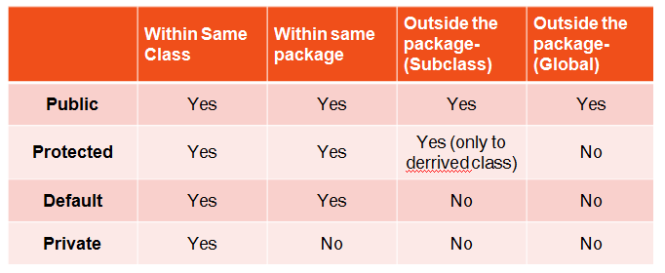
Access Specifiers in Java

Slide 10
Types of Inheritance
Single Inheritance
Multiple Inheritance (Not supported in JAVA)
Multilevel Inheritance
Hierarchical Inheritance
Hybrid (Virtual) Inheritance (Not supported in JAVA)

Slide 11
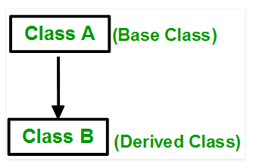
Single Inheritance
In single inheritance, a class is allowed to inherit from only one class. i.e. one sub class is inherited by one base class only.

Slide 12
Single Inheritance (Continue..)
class Animal{
void eat(){System.out.println("eating...");}
}
class Dog extends Animal{
void bark(){System.out.println("barking...");}
}
class TestInheritance
{
public static void main(String args[]){
Dog d=new Dog();
d.bark();
d.eat();
}}

Slide 13
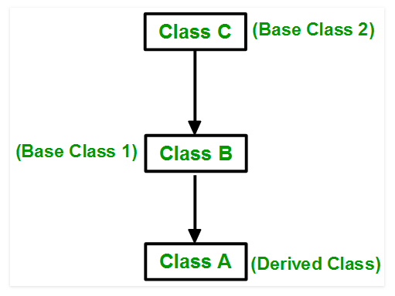
Multilevel Inheritance
In this type of inheritance, a derived class is created from another derived class.

Slide 14
Multilevel Inheritance (Continue..)
class Animal{
void eat(){System.out.println("eating...");}
}
class Dog extends Animal{
void bark(){System.out.println("barking...");}
}
class BabyDog extends Dog{
void weep(){System.out.println("weeping...");}
}
class TestInheritance2{
public static void main(String args[]){
BabyDog d=new BabyDog();
d.weep();
d.bark();
d.eat();
}}

Slide 15
Hierarchical Inheritance
When two or more classes inherits a single class, it is known as hierarchical inheritance. In the example given below, Dog and Cat classes inherits the Animal class, so there is hierarchical inheritance.

Slide 16
Hierarchical Inheritance
class Animal{
void eat(){System.out.println("eating...");}
}
class Dog extends Animal{
void bark(){System.out.println("barking...");}
}
class Cat extends Animal{
void meow(){System.out.println("meowing...");}
}
class TestInheritance3{
public static void main(String args[]){
Cat c=new Cat();
c.meow();
c.eat();
//c.bark();//C.T.Error
}}

Slide 17
Inheritance and constructors in Java
In Java, constructor of base class with no argument gets automatically called in derived class constructor.
For example, output of following program is:
Base Class Constructor Called Derived Class Constructor Called
class Base {
Base() { System.out.println("Base Class Constructor Called "); } }
class Derived extends Base {
Derived() { System.out.println("Derived Class Constructor Called "); }}
public class Main {
public static void main(String[] args) {
Derived d = new Derived();} }

Slide 18
Order of execution of constructor in Multilevel inheritance
class College
{ College() { System.out.println("College constructor executed"); } }
class Department extends College
{ Department() { System.out.println("Department constructor executed"); } }
class Student extends Department
{ Student() { System.out.println("Student constructor executed"); } }
public class OrderofExecution2
{
public static void main(String ar[])
{
new Student();
}
}

Slide 19
Calling superclass constructor using super keyword
class Base {
int x;
Base(int _x) { x = _x; }
}
class Derived extends Base {
int y;
Derived(int _x, int _y) { super(_x); y = _y;
}
void Display() {
System.out.println("x = "+x+", y = "+y);
}
}
public class Main {
public static void main(String[] args) {
Derived d = new Derived(10, 20);
d.Display(); } }

